Slide 1

LCAP Mid-Year
Update Report
2024-2025 Local Control and Accountability Plan (LCAP)
LCAP and State & Federal| LCAP Engagement | February 25, 2025

Slide 2

Background
Senate Bill 114 (2023)
Newly added requirement for LEAs to present a report on the annual update to the Local Control and Accountability Plan (LCAP) and Budget Overview for Parents (BOP):
* on or before February 28 each year
* at a regularly scheduled meeting of the governing board or body of the LEA
The report must include the following:
All available midyear outcome data related to metrics identified in the current LCAP; and,
All available midyear expenditure and implementation data on all actions identified in the current LCAP.

Slide 3

A Mid-Year Update
A communication tool (resource) to inform educational partners with the status of the district’s implementation of actions, meeting metrics, and expending funds.
Informational Only
Present at regularly scheduled board meeting
Deadline: no later than February 28

Slide 4
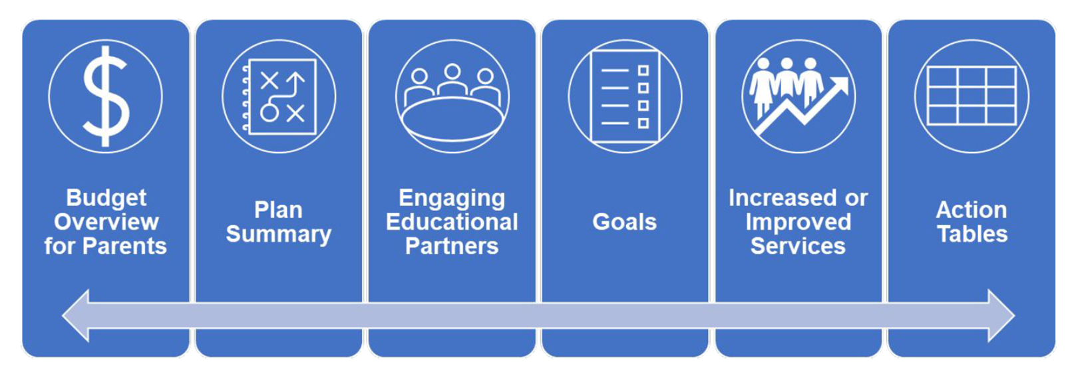
Mid-Year Update
Supporting Resources
Mid-Year LCAP Update – February 28
LCAP Federal Addendum – June 30
DECISIONS MADE TODAY
ARE WHAT IS BEST
FOR KIDS TO IMPROVE
EDUCATIONAL OUTCOMES
LCAP webpage: https://www.stocktonusd.net/lcap

Slide 5
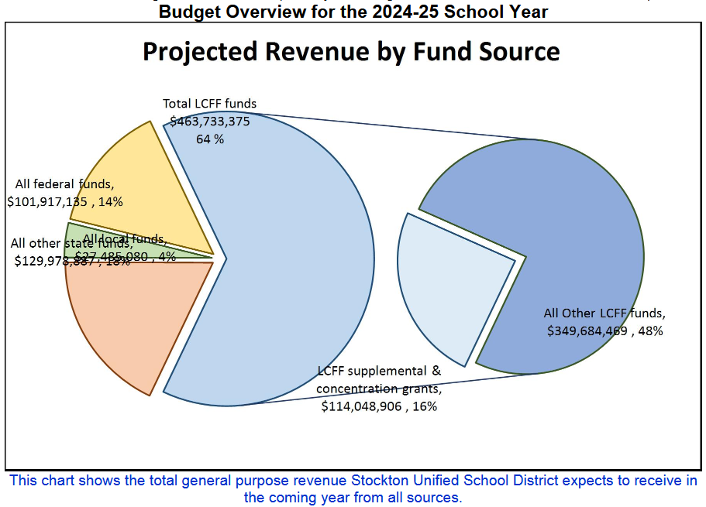
Budget Overview for parents (BOP)
Stockton Unified School District initially adopted the LCAP and Budget on June 25, 2024, which was based on the May Revise.
The district re-adopted the LCAP on September 13, 2024
No changes were made to the Budget Overview for Parents for the Mid-Year Report.
Item | Adopted in BOP
Total LCFF Funds | $463,733,375
LCFF Supplemental/ Concentration Grants | $114,048,906

Slide 6
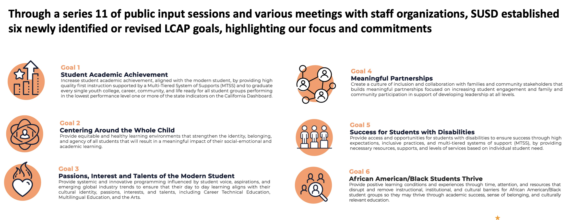
SUSD 2024-2027 LCAP Goals
Goal 1 – 6: LCFF Base and LCFF S&C funded
Goal 7 & 8: Equity Multiplier funded

Slide 7
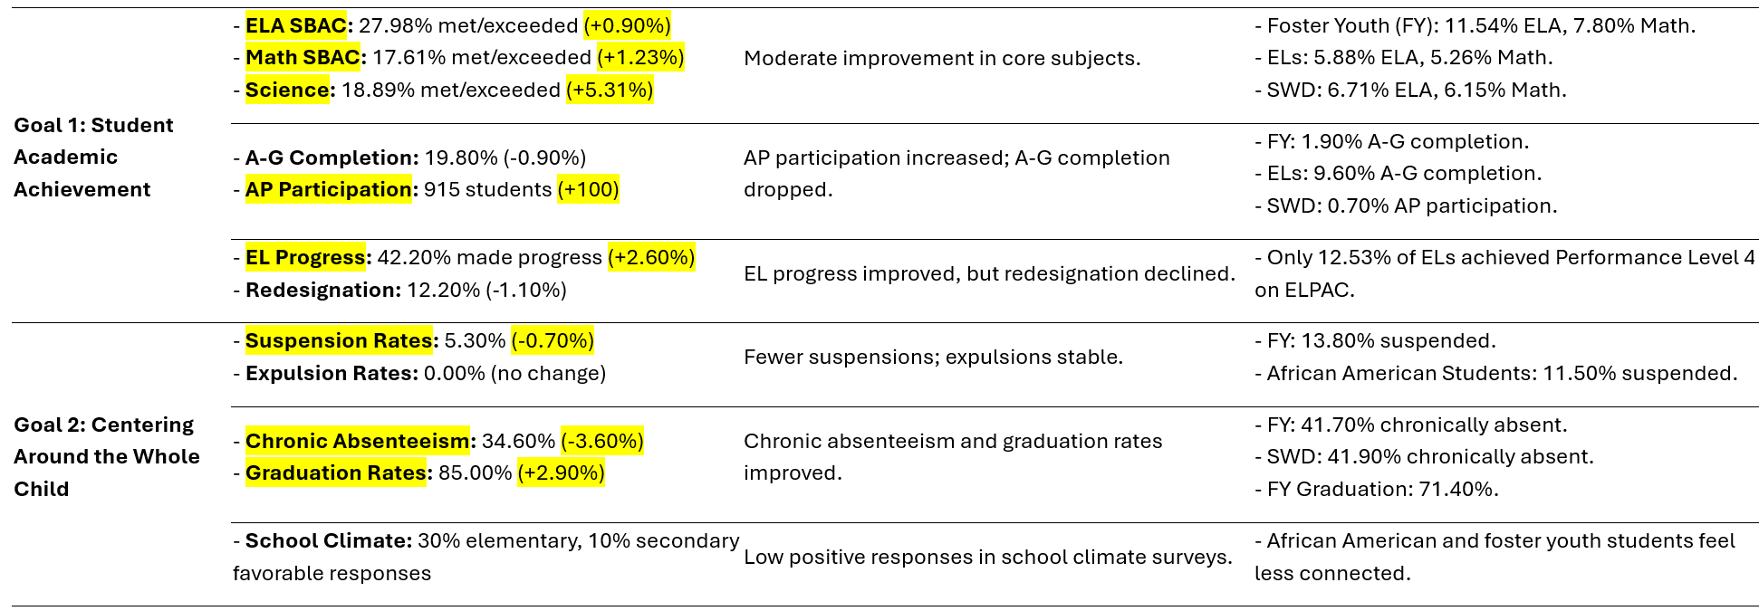
Supporting annual measurable outcomes

Slide 8
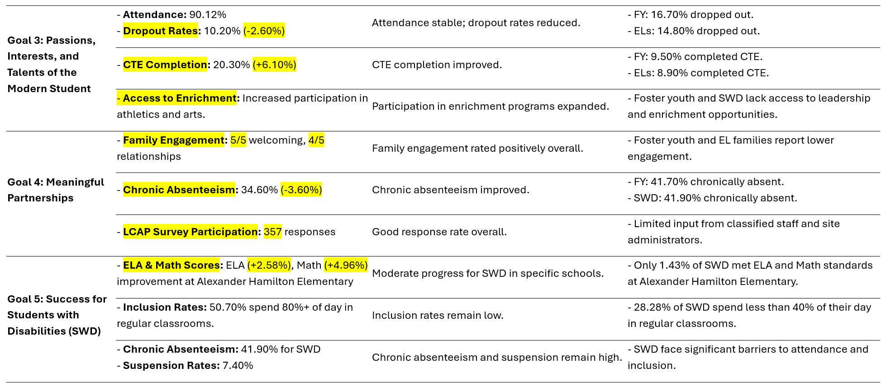
Supporting annual measurable outcomes

Slide 9
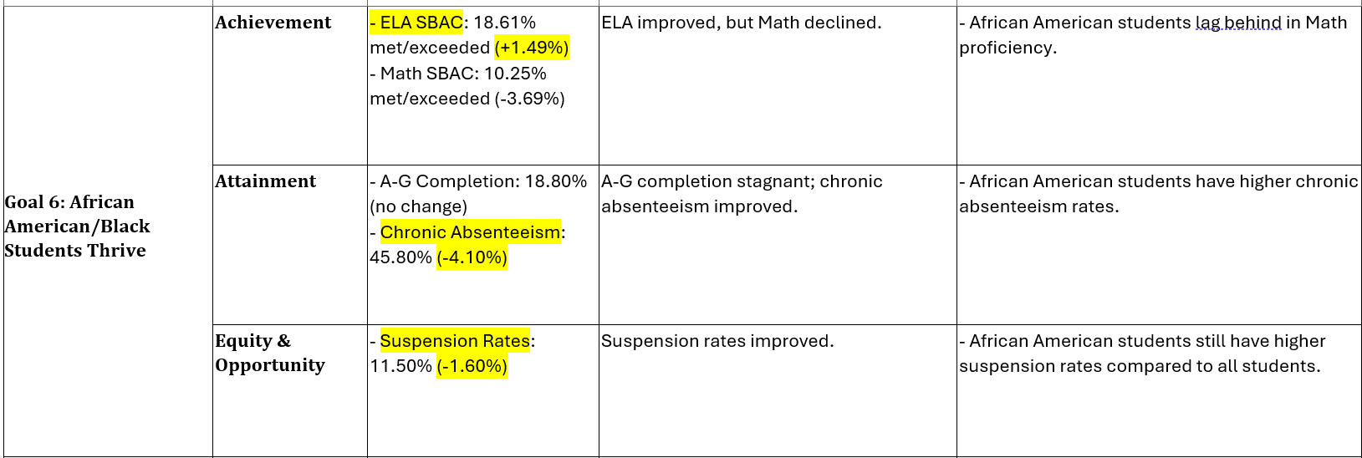
Supporting annual measurable outcomes

Slide 10
Action outcomes and implementation
Nearly 100%
of LCAP Action Status is
Ongoing Implementation

Slide 11
Expenditures - July 1, 2024 - Dec. 31, 2024
Expenditure by Goal
41.03%
of LCAP Actions are
Expended
Goal | $ Expended
Goal 1 – Student Academic Achievement | $ 11,419,785.16
Goal 2 – Centering Around the Whole Child | $ 106,322,790.94
Goal 3 – Passions, Interest and Talents of the Modern Students | $ 3,999,832.92
Goal 4 – Meaningful Partnerships | $ 1,343,958.05
Goal 5 – Success for Students with Disabilities | $ 0.00
Goal 6 – African American/Black Students Thrive | $ 4,075.00
Expenditure Reporting
Total Allocated: $299,954,355.00
Total Expended:
$123,090,442.07
Goal 1 – 6: LCFF Base and LCFF S&C funded
Goal 7 & 8: Equity Multiplier funded

Slide 12
Expenditures by Action - GOALs 1-6
2
Meaningful Partnerships
Action | Total Budgeted | Total Expended
4.1 | $1,451,404.00 | $509,931.45
4.2 | $1,628,471.00 | $733,619.96
4.3 | $496,318.00 | $100,406.64
4.4 | $25,000.00 | $0.00
4
Student Academic Achievement
Action | Total Budgeted | Total Expended
1.1 | $1,969,829.00 | $1,017,475.92
1.2 | $1,822,404.00 | $780,972.19
1.3 | $345,226.00 | $164,265.93
1.4 | $46,515.00 | $0.00
1.5 | $985,220.00 | $433,984.82
1.6 | $2,005,141.00 | $832,340.21
1.7 | $5,365,047.00 | $0.00
1.8 | $533,570.00 | $28,469.21
1.9 | $598,443.00 | $323,426.57
1.10 | $375,824.00 | $31,575.19
1.11 | $3,391,540.00 | $1,979,740.81
1.12 | $5,772,097.00 | $3,031,123.32
1.13 | $1,233,116.00 | $300,041.02
1.14 | $1,056,261.00 | $386,863.57
1.15 | $6,126,405.00 | $1,930,545.40
1.16 | $900,000.00 | $178,961.00
Centering Around the Whole Child
Action | Total Budgeted | Total Expended
2.1 | $675,340.00 | $372,533.18
2.2 | $150,000.00 | $2,676.31
2.3 | $38,000.00 | $18,036.46
2.4 | $133,252.00 | $23,153.49
2.5 | $1,000,000.00 | $183,795.30
2.6 | $275,877.00 | $126,425.75
2.7 | $2,940,851.00 | $1,143,813.37
2.8 | $135,999.00 | $0.00
2.9 | $1,040,019.00 | $429,007.31
2.10 | $1,957,078.00 | $772,227.83
2.11 | $19,120,256.00 | $1,807,507.74
2.12 | $4,753,481.00 | $1,975,668.19
2.13 | $242,227.00 | $147,950.71
2.14 | $7,012,754.00 | $3,490,975.67
2.15 | $7,505,134.00 | $3,967,895.29
2.16 | $12,539,676.00 | $3,960,844.91
2.17 | $60,000.00 | $33,142.14
2.18 | $10,250,068.00 | $151,182.04
2.19 | $2,368,279.00 | $1,064,511.13
2.20 | $300,000.00 | $23,342.71
2.21 | $170,360,612.00 | $85,180,306.00
2.22 | $20,000.00 | $1,123.41
2.23 | $1,578,767.00 | $1,143,046.00
2.24 | $607,252.00 | $303,626.00
Success for Students with Disabilities
Action | Total Budgeted | Total Expended
5.1 | $23,000.00 | $0.00
5.2 | $26,000.00 | $0.00
5.3 | $24,000.00 | $0.00
5.4 | $50,000.00 | $0.00
5.5 | $50,000.00 | $0.00
5.6 | $35,000.00 | $0.00
5.7 | $75,000.00 | $0.00
5.8 | $50,000.00 | $0.00
1
5
African American/Black Students Thrive
Action | Total Budgeted | Total Expended
6.1 | $250,000.00 | $4,075.00
6.2 | $250,000.00 | $0.00
6.3 | $200,000.00 | $0.00
6.4 | $587,144.00 | $0.00
6.5 | $542,456.00 | $0.00
6.6 | $565,169.00 | $0.00
6.7 | $1,891,544.00 | $0.00
6.8 | $713,687.00 | $0.00
6
3
Passions, Interest and Talents of the Modern Students
Action | Total Budgeted | Total Expended
3.1 | $947,182.00 | $278,339.42
3.2 | $3,000,000.00 | $1,220,700.90
3.3 | $6,335,251.00 | $2,390,879.83
3.4 | $3,221,169.00 | $109,912.77

Slide 13

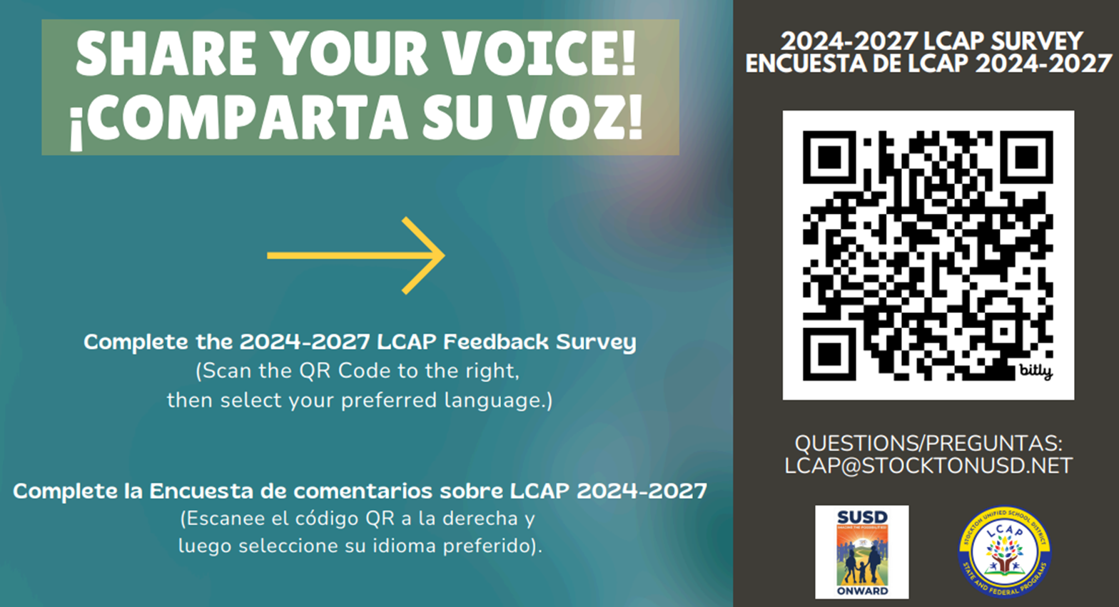
Your Feedback matters

Slide 14
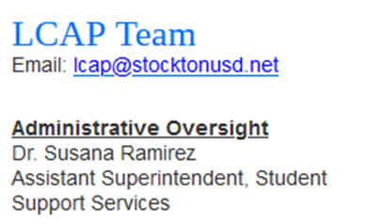
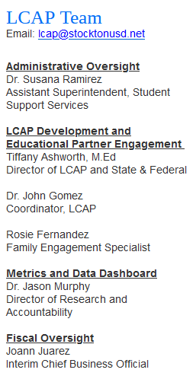
THANK YOU!

